Slide 1

COLLEGE MANAGEMENT SYSTEM
TEAM MEMBERS
P.Nikitha(TL)
T.Sindhu
B.Chandana sai rekha
K.Mamatha
A.Preethi
Presented By: P.Nikitha

Slide 2
Project Description/Case Study
Abstract
This project is aimed at developing a Repository and each Engine for alumni of the college, which is of importance to a college. The College Management System
is an Internet based application that can be accessed throughout the World. Anyone can access the search Engine to know about any Alumni of that college but can’t able to add. Alumni can only update the database when they are in the college.
This system can be used as an application for the College Management System
to manage the college information and student information. Student logging should be able to upload the information of the e employee.

Slide 3
Existing System
The Existing system is a computerized system but which is maintained at individual databases i.e., in excel sheets, it’s a time delay process. And maintaining all the records in Excel sheets is difficult. If they want any record, they have to search all the records. It doesn’t provide multiple user accessibility and also doesn’t have different user privileges. So, the system is not accessible for all the employees of the organization.
Proposed System
The Proposed system is a computerized system but which is maintained at Centralized databases i.e., in automated forms it’s a very fast process. And maintaining all the records in online systems database which makes it very easy to access and retrieve data from the database. If they want any record, they can easily search all the records. It provides multiple user accessibility and also has different user privileges. So, the system is accessible for all the employees of the organization.

Slide 4
Users with Functions
Student Users
User can Register to Alumni
Students can login to the system with the generated hall-ticket no
Update the Profile
Students can see all student information in the alumni
They can see the events details
Students also can see the campus interview details
Students can watch the tutorials
Students can give their exams
Admin Users
Has full access to all the modules of this system.
Can see all the details of students and faculty
Responsible for the accounts of all students.
Update, modify or delete event details
Update, modify or delete campus interviews details
Prepares and submits also Daily reports, user reports, event reports, etc.

Slide 5
Faculty User
Faculty users
Faculty can add the tutorials
Faculty can register to get their individual id through mail
Faculty can see the results
Faculty cab prepare exams
Guest User
Guest can only see the home page
Guest can see the events
Guest can see the news

Slide 6
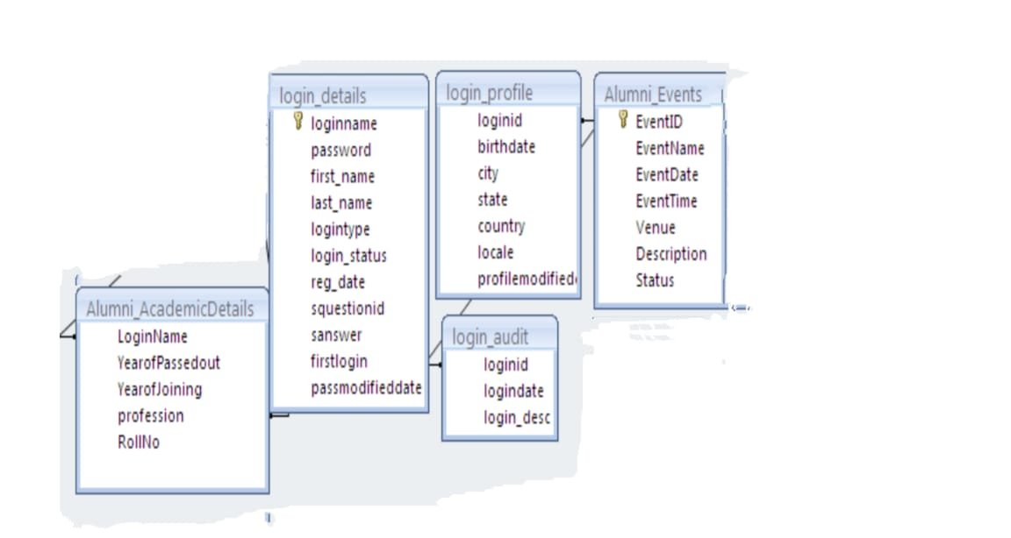
Project :ER Diagram

Slide 7
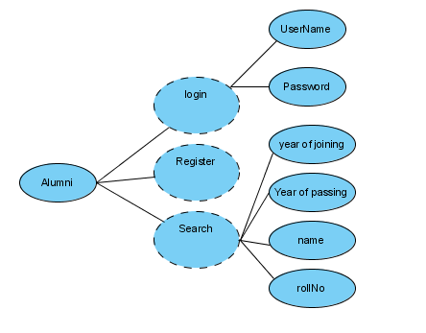
Use case diagram

Slide 8
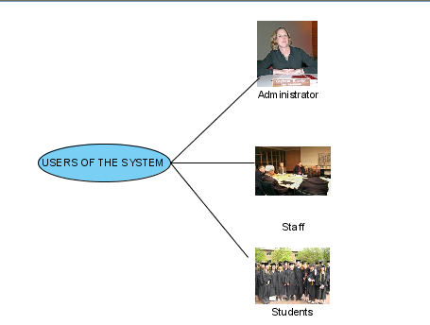
users of the system

Slide 9
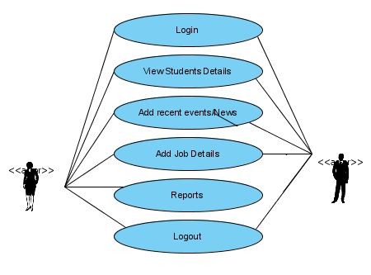
Administrator Use Case

Slide 10
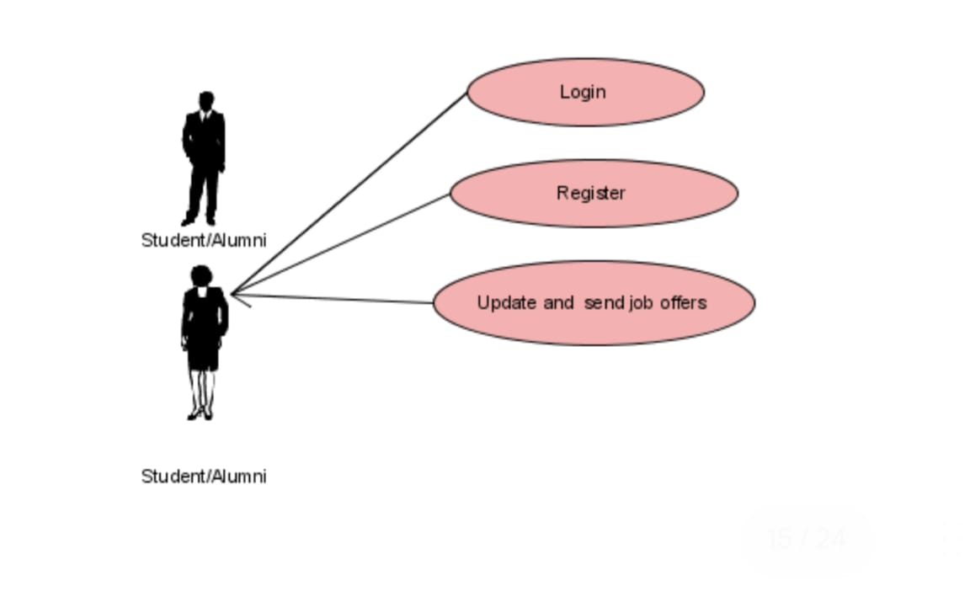
Student/Alumni case

Slide 11
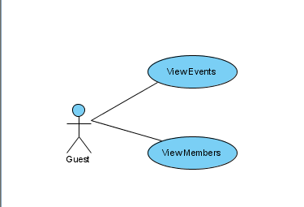
Guest Use Case

Slide 12
Limitations and Scope for Future Enhancements
Limitations of the system:
• Only the permanent employees can access the system.
• System works in all platforms and its compatible environments.
• Advanced techniques are not used to check the authorization.
Future Enhancements:
It is not possible to develop a system that makes all the requirements of the user. User requirements keep changing as the system is being used.
Some of the future enhancements that can be done to this system are:
• As the technology emerges, it is possible to upgrade the system and can be adaptable to desired environment.
• Because it is based on object-oriented design, any further changes can be easily adaptable.
• Based on the future security issues, security can be improved using emerging technologies.
• Attendance module can be added
• sub admin module can be added

Slide 13
Project Summary
The College management system is a web-based application for primarily providing training to the employees who provide customized solutions to meet organizational needs.
This application software has been computed successfully and was also tested successfully by taking “test cases”.
It is user friendly, and has required options, which can be utilized by the user to perform the desired operations.
The software is developed using Java as front end and Oracle as back end in Windows environment.
The goals that are achieved by the software are:
✓ Instant access.
✓ Improved productivity.
✓ Optimum utilization of resources.
✓ Efficient management of records.
✓ Simplification of the operations.
✓ Less processing time and getting required information.
✓ User friendly.

Slide 14
Software Requirements
Operating System : Windows XP/2003 or Linux
User Interface : HTML, CSS
Client-side Scripting : JavaScript
Programming Language : Java
Web Applications : JDBC, Servlets, JSP
IDE/Workbench : My Eclipse
Database : MySQL
Server Deployment : Tomcat
Hardware Requirements
Processor : Pentium IV
Hard Disk : 40GB
RAM : 256MB

Slide 15
THANKYOU

